Slide 1
MCC Asset Register
7 April 2017

Slide 2
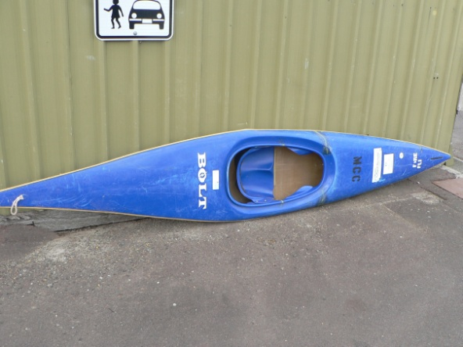
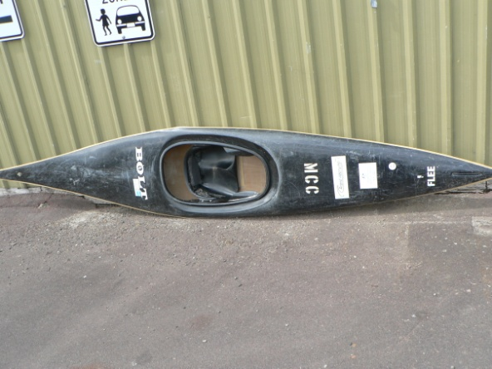
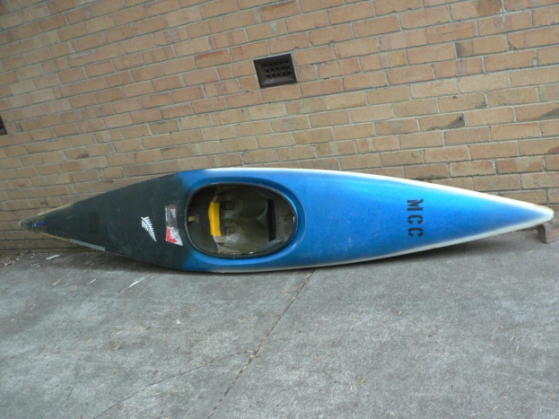
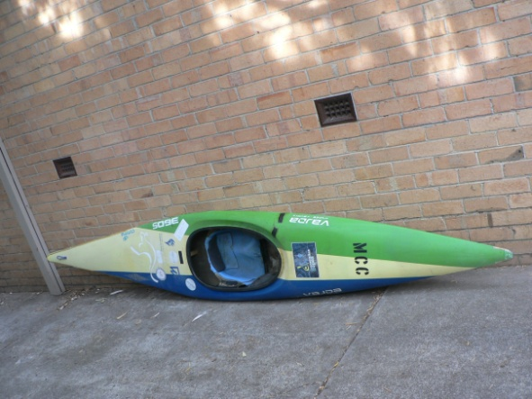
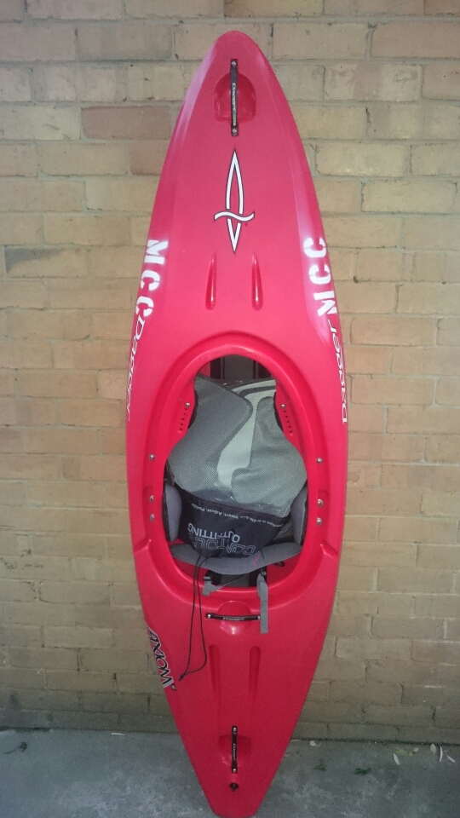
K1 Boats
3x White Sonic Galasport
1x Blue Bolt
2x Black Bolts
*one is missing
1x Unknown
1x Vajda 360
1x Dager

Slide 3
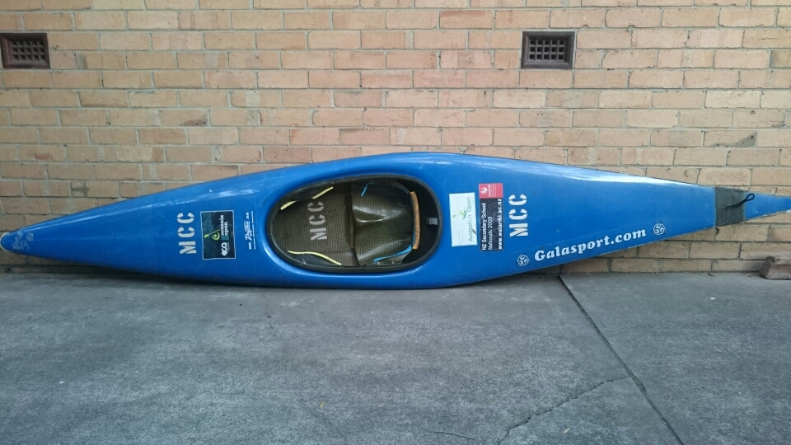
K1 - Continued
There is still a range of new Glasport boats and other boats that need to be labeled and photographed.
*Currently missing

Slide 4
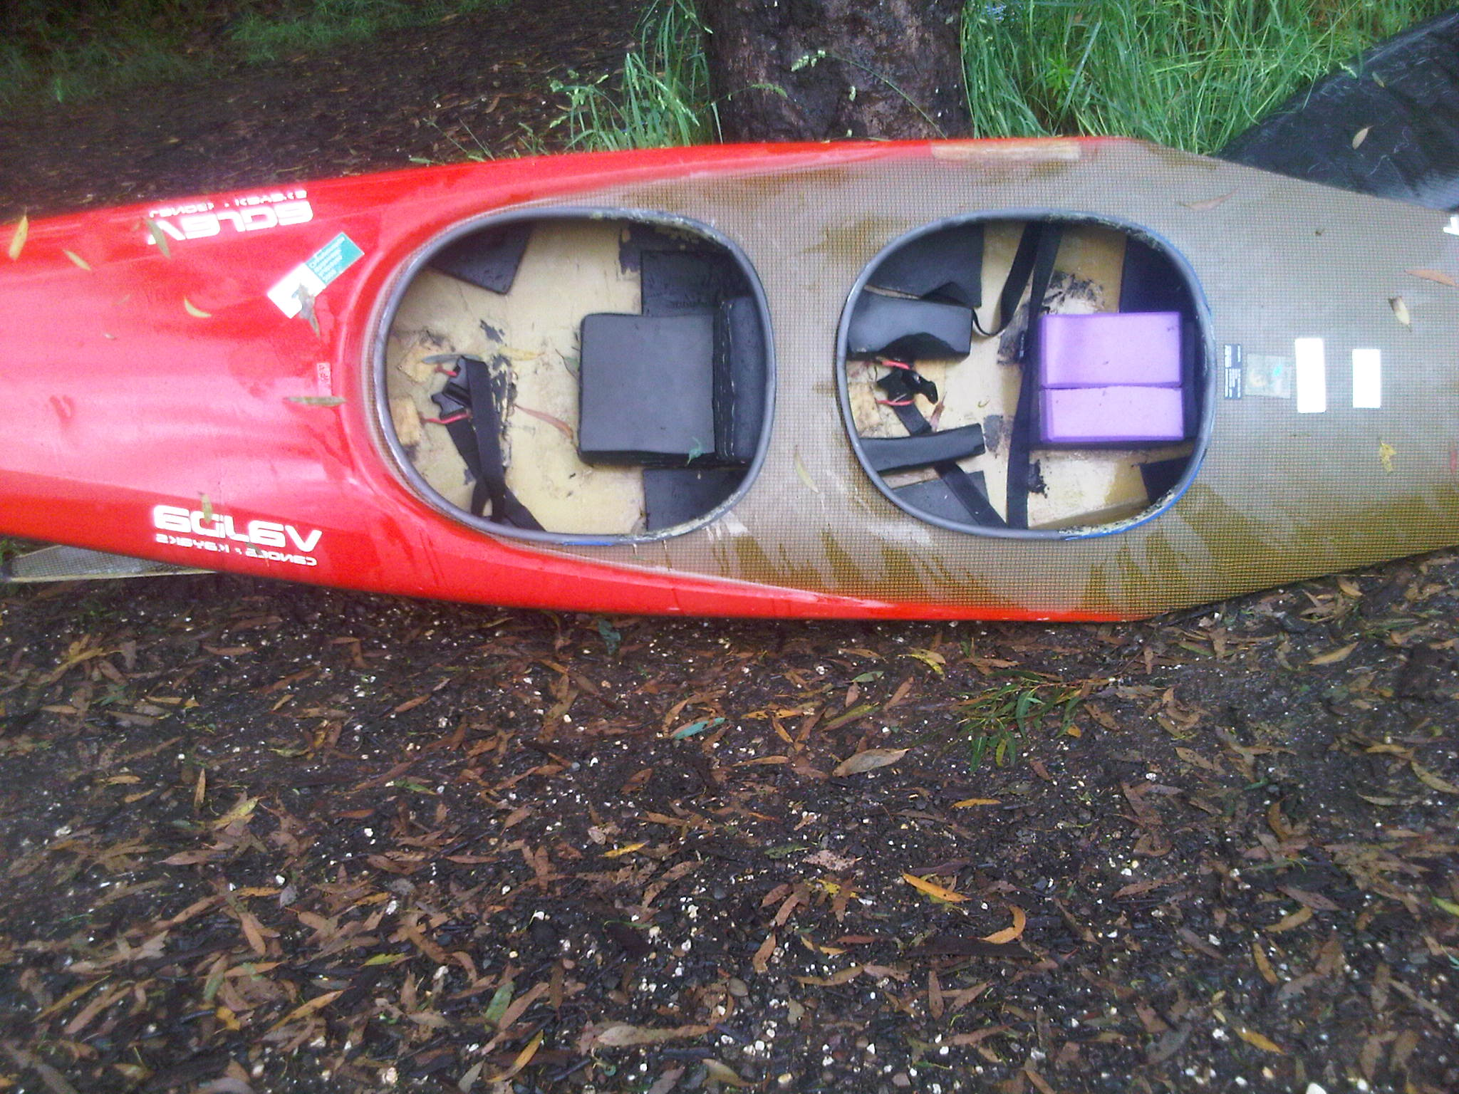
C2 Boats

Slide 5
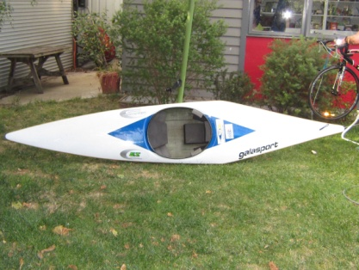
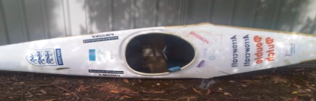
C1 Boats

Slide 6
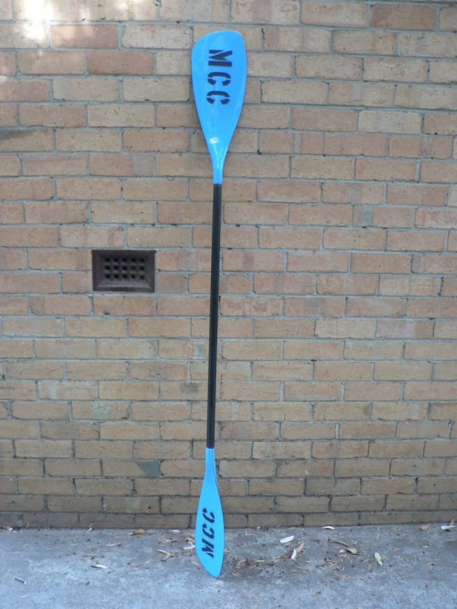
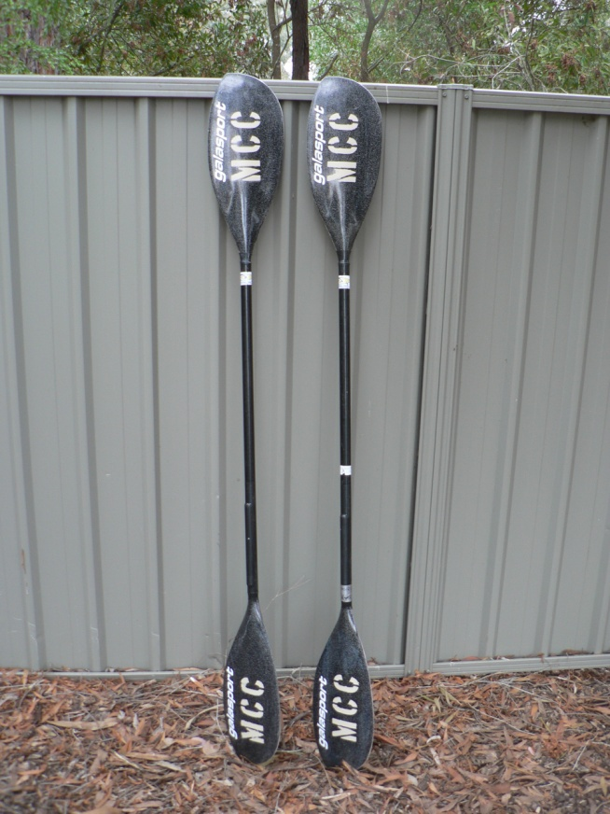
K1 Paddles (+ one C1 Paddle)
5x G power paddles
Two Galasport Paddles
Purchased new 2012

Slide 7
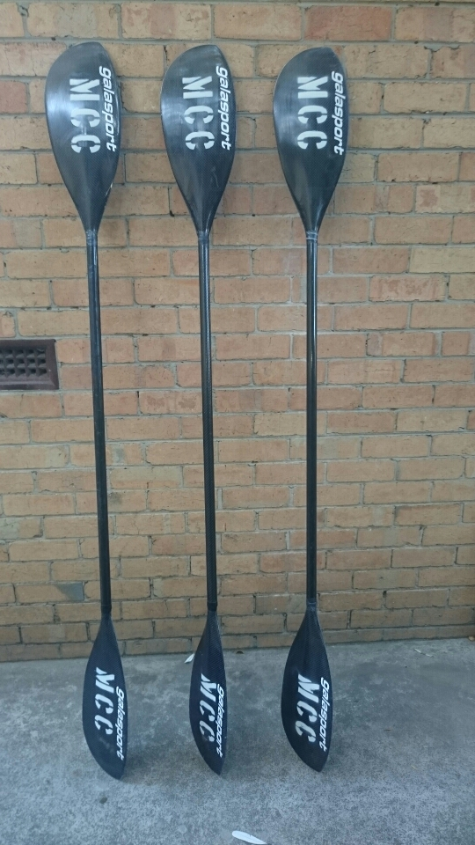
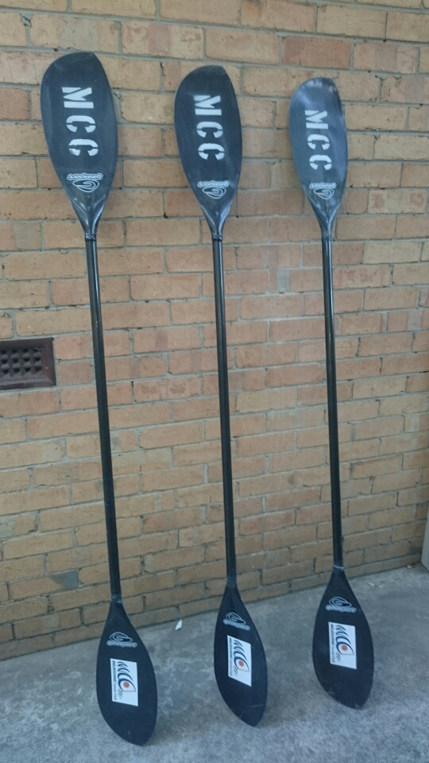
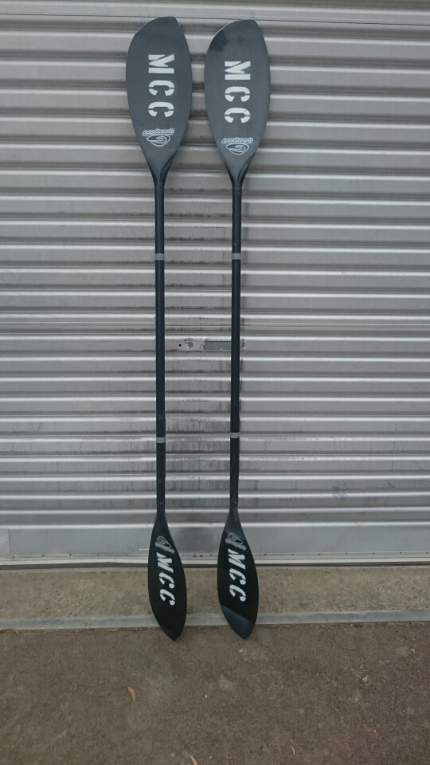
K1 paddles Continued
-Front
-Back
3x Galasport paddles , as of March 2017
2x Galasport paddles, as of March 2016

Slide 8
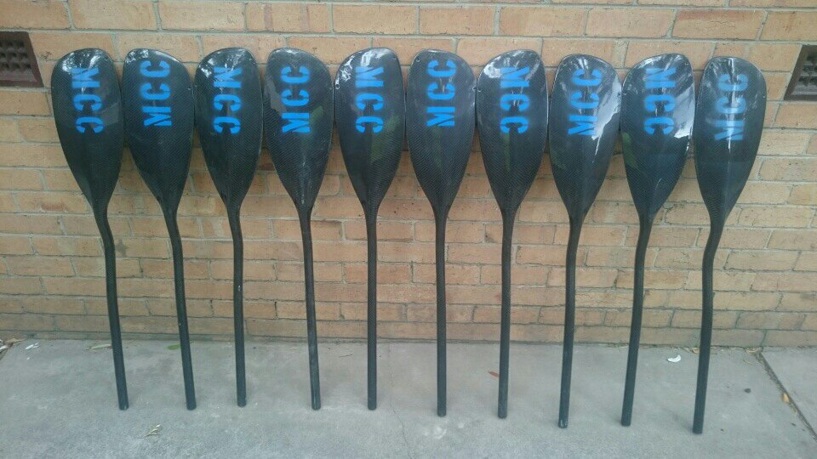
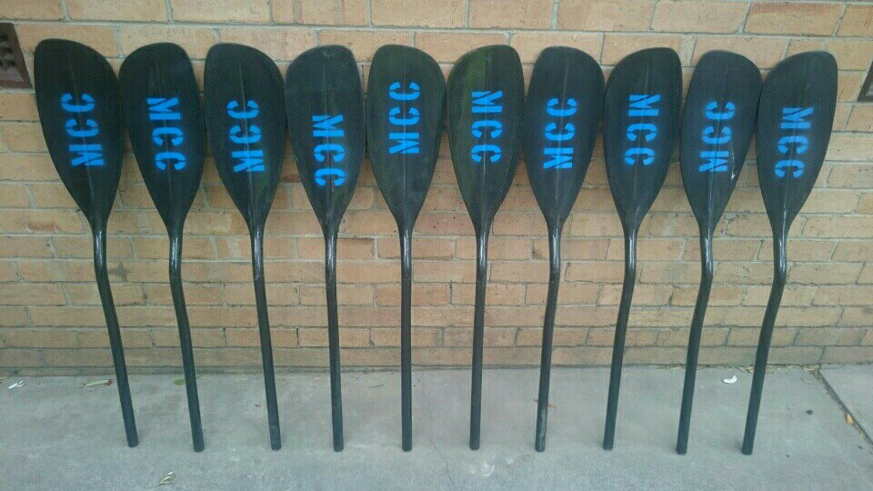
K1 Paddles Continued
5 x Senior sized Letman Paddles as of 25th Feb 2018

Slide 9
K1 Paddles Continued
There are still more paddles to be counted and photographed.

Slide 10
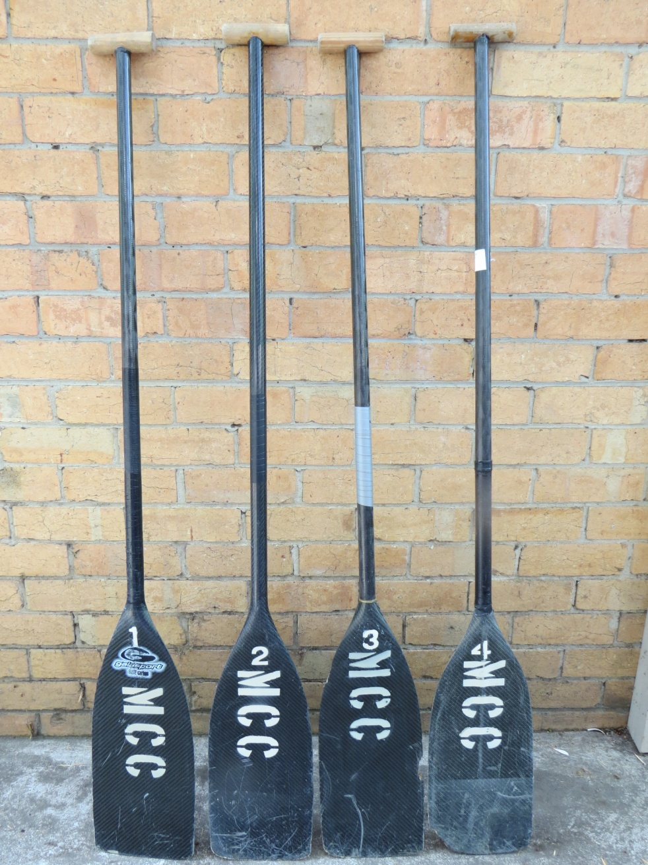
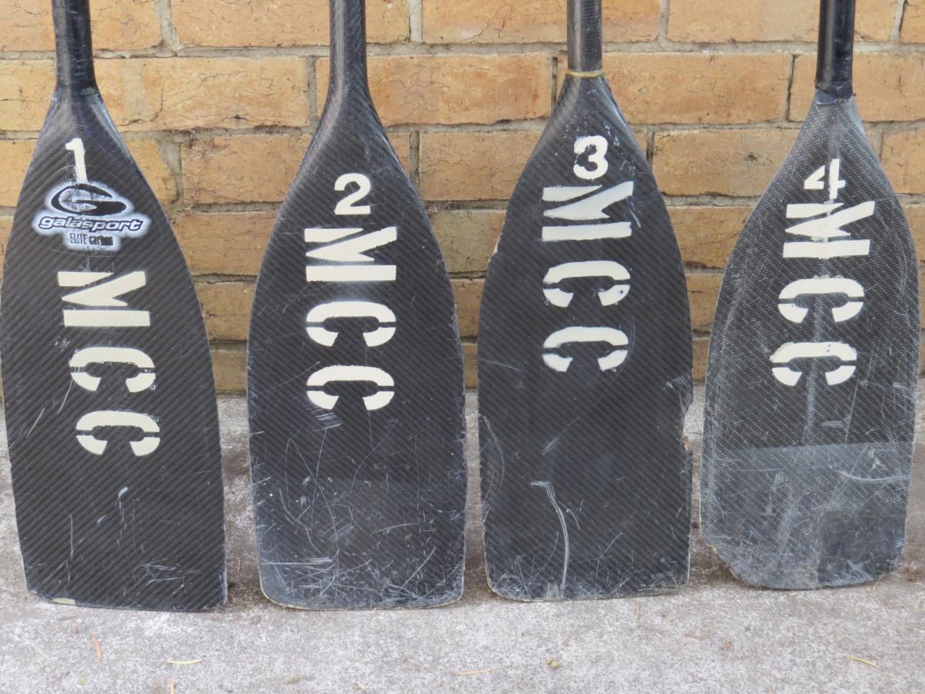
C1 Paddles

Slide 11
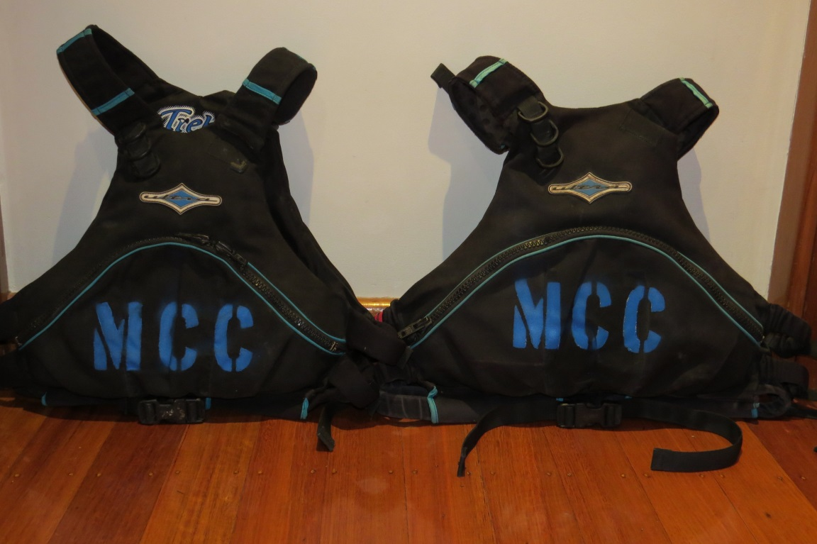
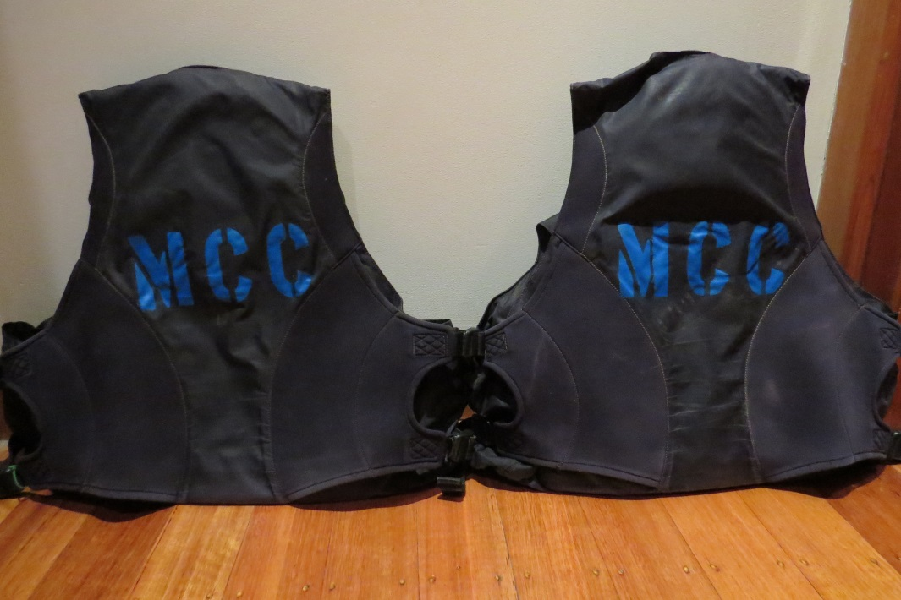
Personal Floatation Devices
These 4 PFDs were added 22 July 2014

Slide 12
PFD
The club has a handful of PFD’s that need to be counted and photographed

Slide 13
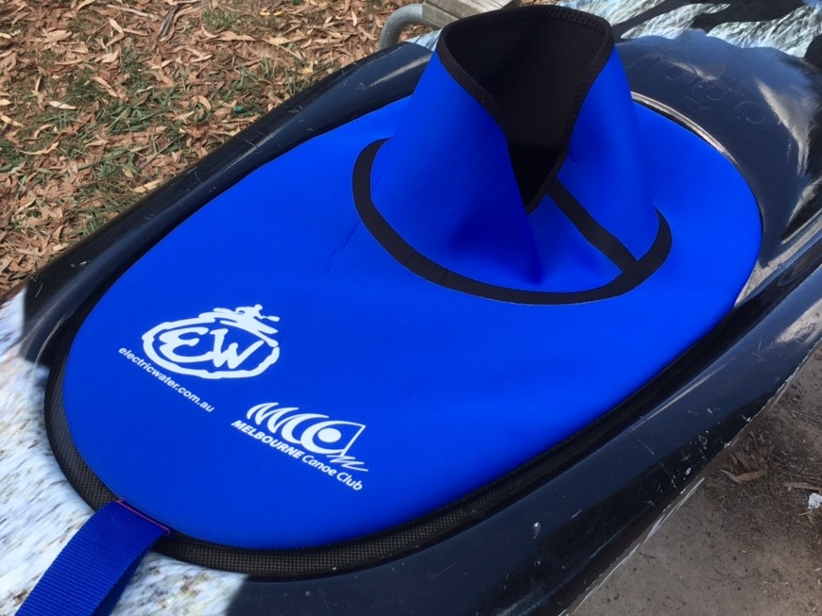
Decks
10 electric water MCC blue K1 decks
The club has other decks that must photographed and counted

Slide 14
Helmets
The club has a large amount of helmets that need photographing and counting

Slide 15
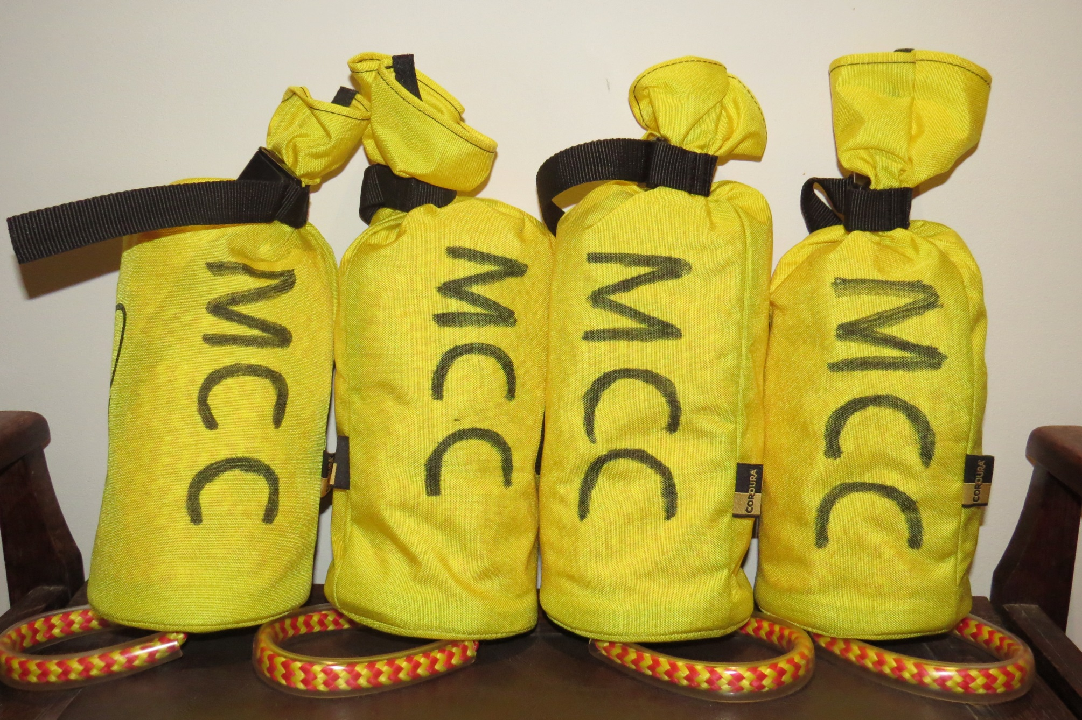
Four Throw Bags (added 22 July 14)

